Slide 1
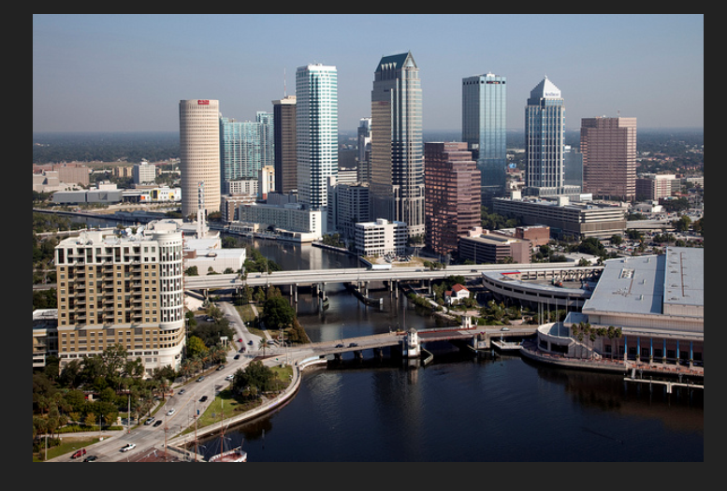
SAVE THE DATE
Southern Area
AIM Meeting
Tuesday
April 17, 2018
Renaissance Tampa International Plaza Hotel
4200 Jim Walter Blvd
Tampa FL 33607
Phone: (813) 877-9200
SAaim@usps.gov

